Slide 1

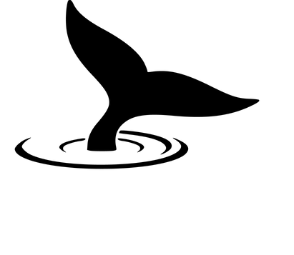

Dr. Fish
AI Project
Presented By:
Santosh Yadav

Slide 2
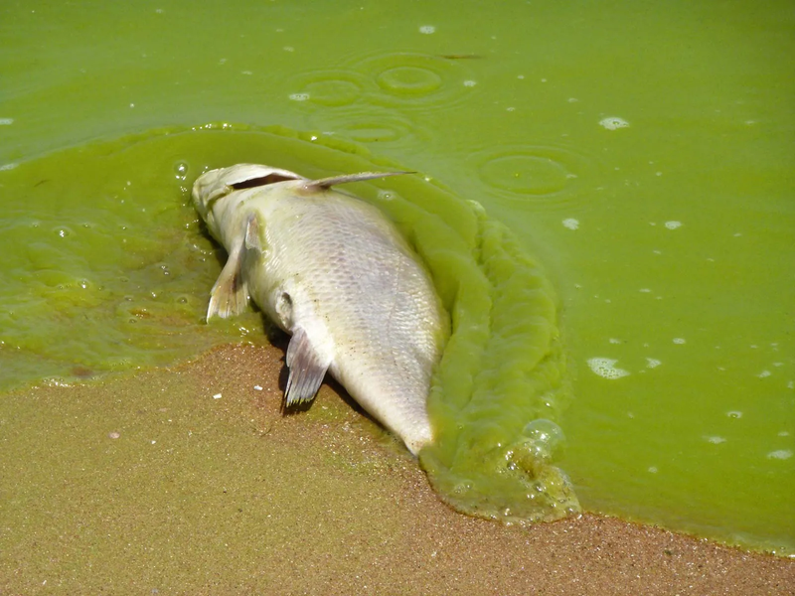
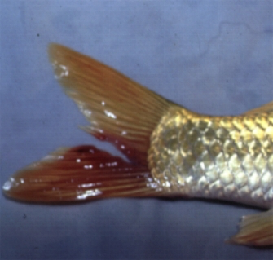
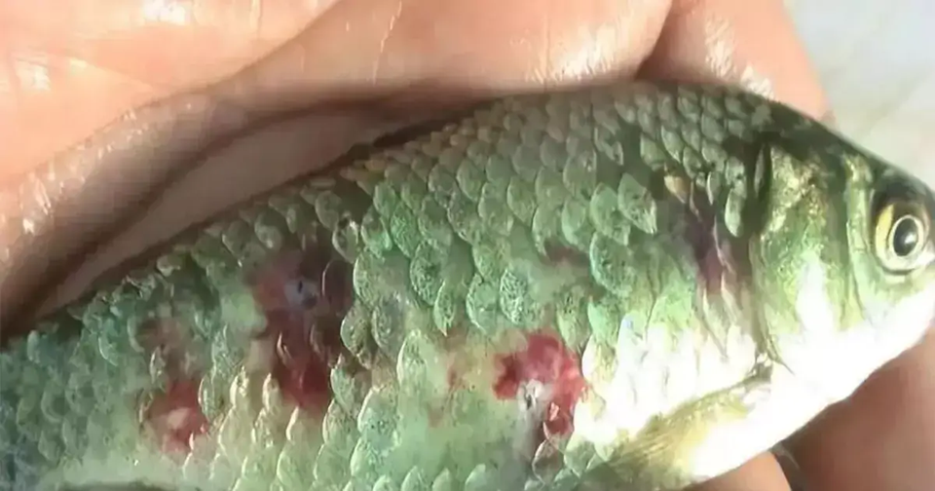
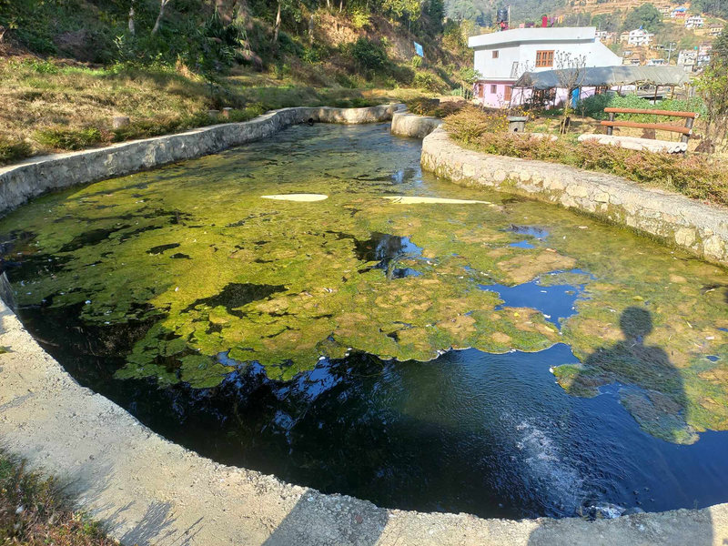
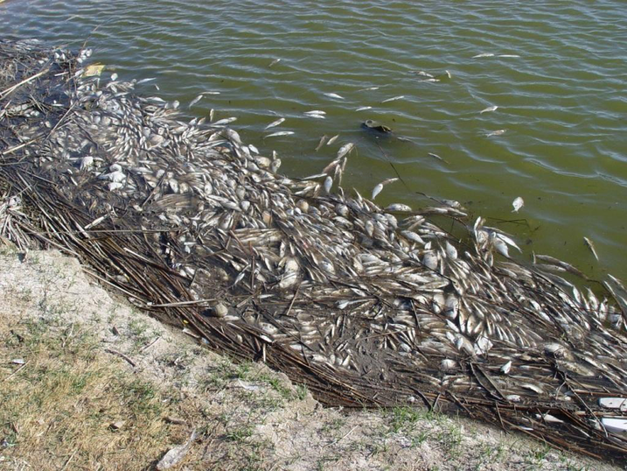

Slide 3

Domestic Data
Figures that concerns Us
~70,000 METRIC TONS
$220
MILLION
$21.2
MILLION
Nepal’s Fish Production 2021
Nepal’s Fish Production in 2021
Annual Loss due to disease
in fish and fish fry
Source I : Department of Livestock Services, Government of Nepal
Source II : Fisheries and Aquaculture Journal

Slide 4
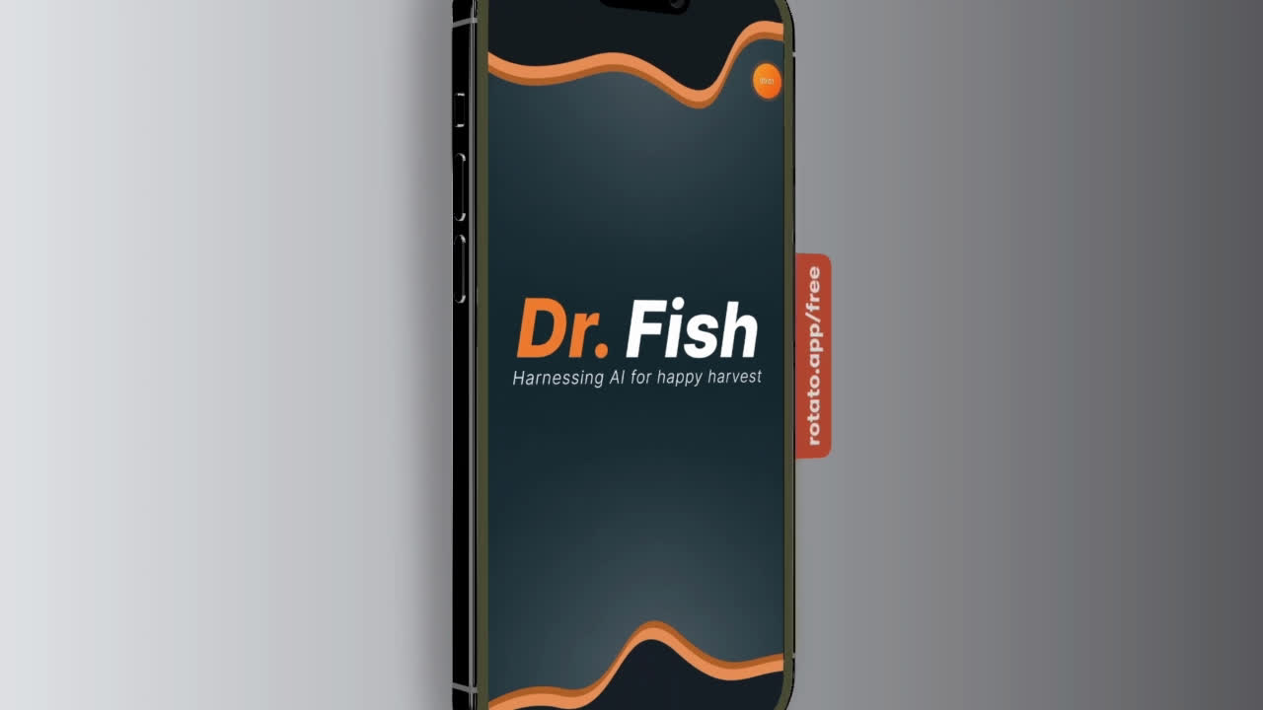

Slide 5
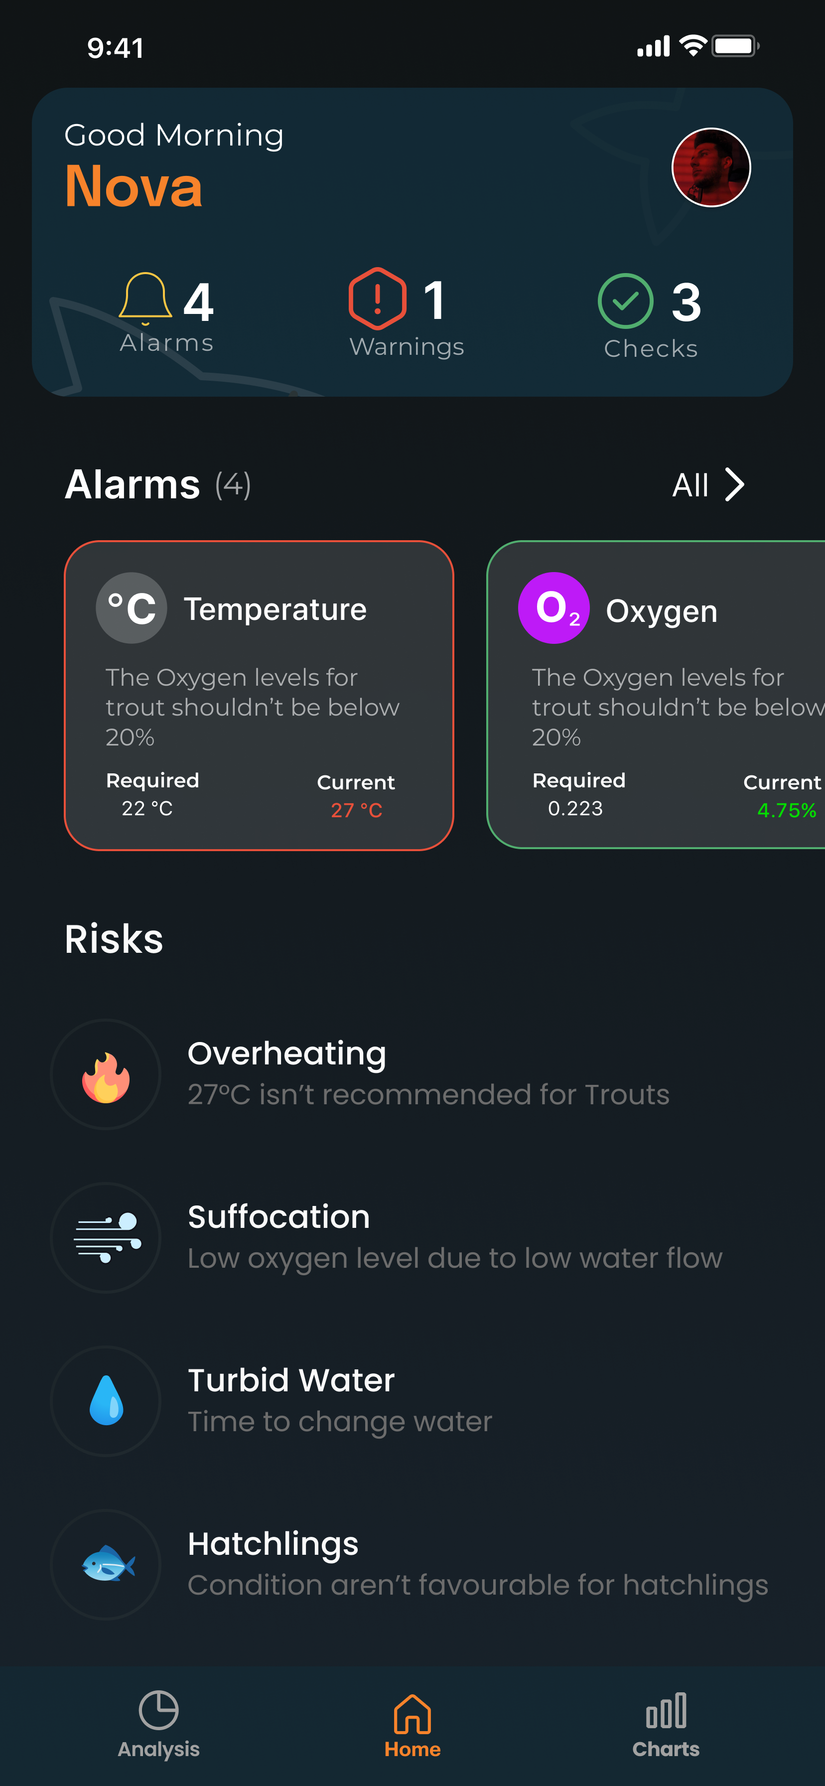
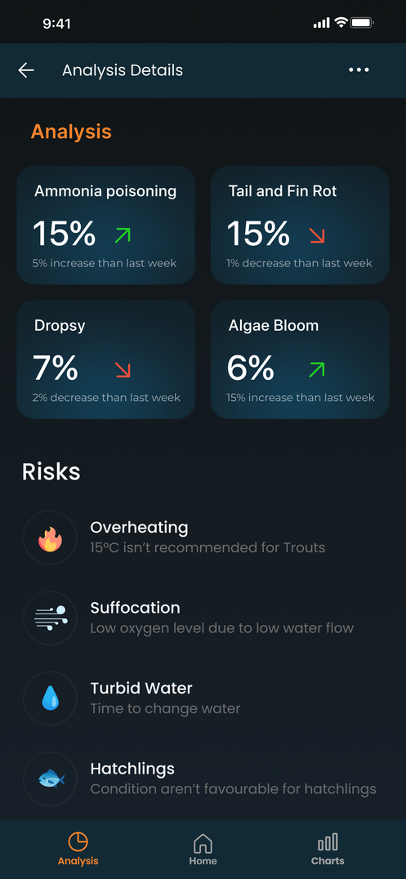
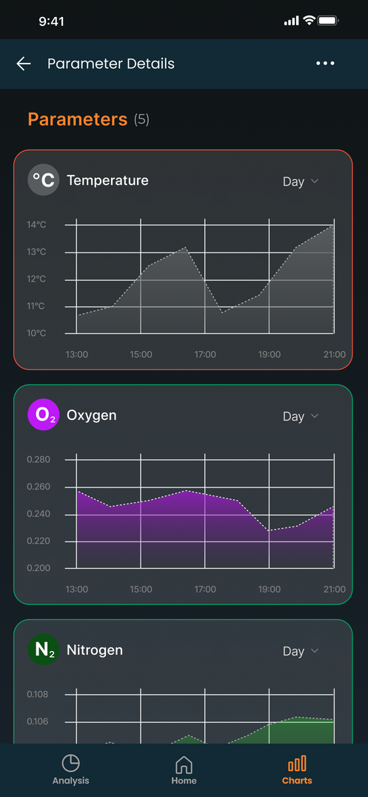








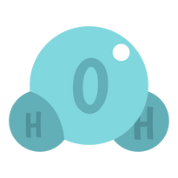
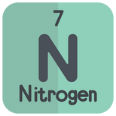
Introduction
Dr Fish is an IOT-based AI-driven monitoring system designed for aquaculture.
Temperature
pH
Turbidity
Oxygen
Nitrogen

Slide 6
Major Features
1. Daily Monitoring
Threshold-based Alarms
Can be Integrated for automatic infrastructure management
6

Slide 7
Major Features
2. Analysis
Context-specific action recommendations
Percentage-based disease risk updates
Safeguard alerts for potential algae blooms.
7

Slide 8
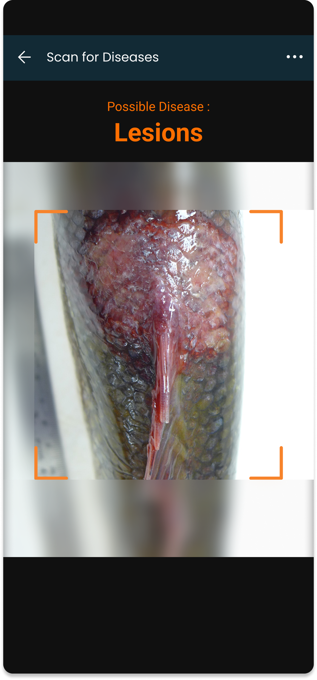
Major Features
3. Disease Detection
Image-based disease classification.
4 Diseases in total (EUS, Fin Lesions, Tail and Fin Rot, Popeye disease)
8

Slide 9
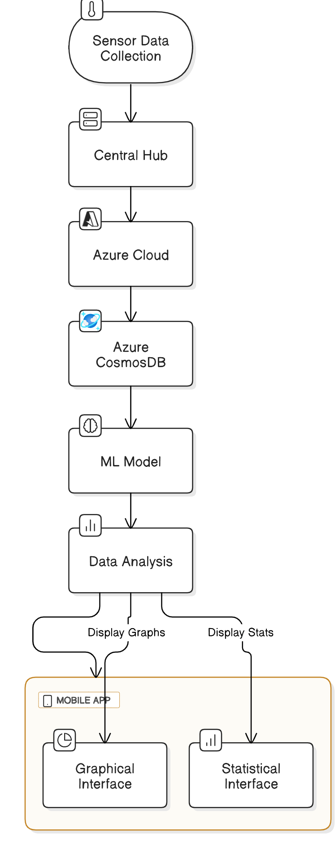
System Flow Diagram

Slide 10
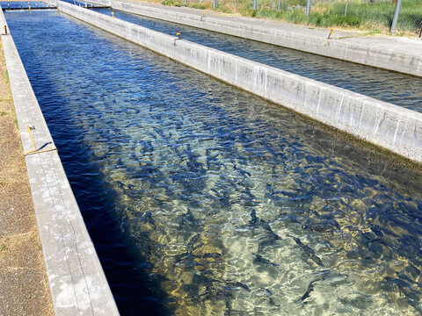
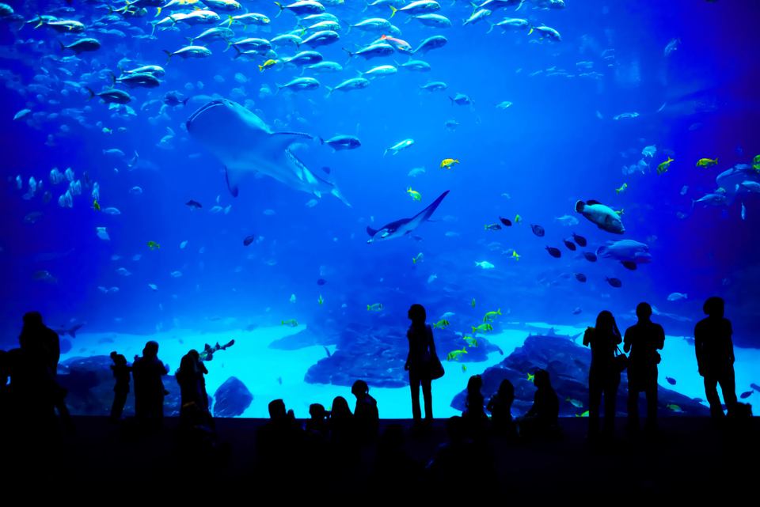
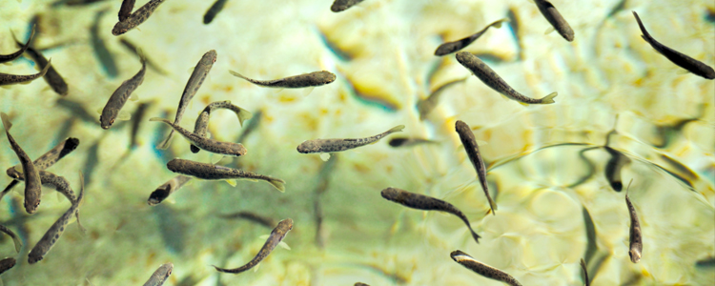
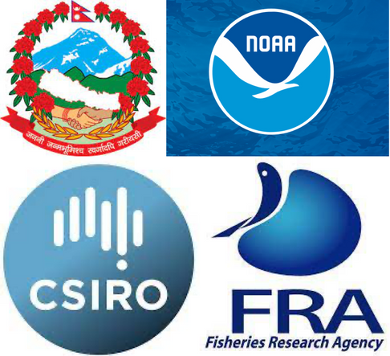
Customer Segments
01
02
03
04
Local -Industrial
Fish farmers
Aquariums
Hatcheries
Research Agencies

Slide 11
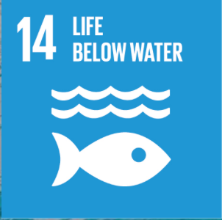



SDG Alignment
Dr. Fish leverages IoT, and machine learning to revolutionize fish farming.
Sustainable management of marine ecosystems
Helps in economic growth from regional to global levels

Slide 12

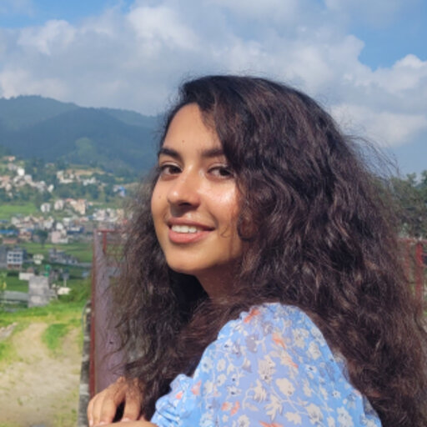


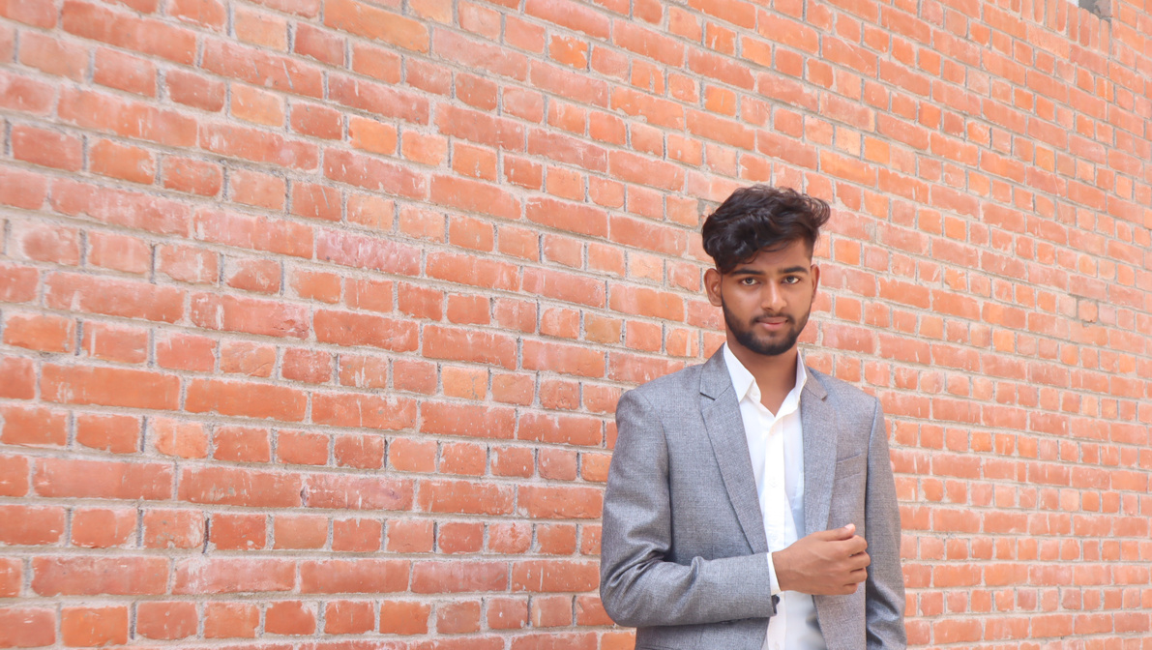
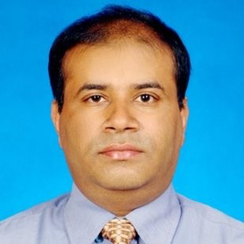
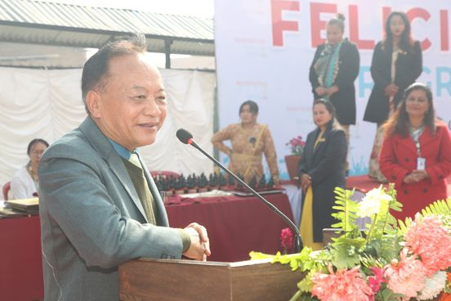
Dr.Fish’s core team
Aakriti Poudel
Sugat Sujaku
Diwas Parajuli
Santosh Yadav
AI/ML developer
Backend Developer
Designer
Full-Stack developer
Dr. Gajendra Sharma
Tek Bahadur Gurung
Mentor
Mentor
Prof at KU
IT and Services Professional
Principal Scientist & Executive Director at Nepal Agricultural Research Council

Slide 13
Thank you!

